Slide 2
Propuesta de valor Fastener Fair Mexico
Fastener Fair Mexico covers all areas of the fastener and fixing industry and provides real insight into industry trends and key information about the latest developments in this sector. The exhibition is the international platform for manufacturers, wholesalers, distributors and suppliers of fastener and fixing technology.
As part of the most important network of international shows for the industry with counterpartners in the USA, GERMANY, ITALY, INDIA, TAIWAN AND CHINA, the Mexican edition serves the worldwide industry.
At Fastener Fair Mexico, products and services from the following industry sectors will be presented:
Industrial fasteners and fixings
Construction fixings
Assembly and installation systems
Fastener manufacturing technology
Storage, distribution, factory equipment
Information, communication and services.

Slide 3

Attendees
2019 | 2,220
2018 | 1,620
37%
International
Domestic
Organized by

Slide 4




Industry in Mexico
Baja California
Chihuahua
Coahuila
Nuevo León
Norte
7%
40%
9%
44%
10%
33%
9%
44%
1st place GDP in your state:
Coahuila - 35.2%
Automotive assembly industry
Chihuahua
EXPO NACIONAL FERRETERA DATA
Aguascalientes
10%
30%
Bajio
Interested in fasteners and fixings products
Guanajuato
1st place in GDP in their states
Querétaro - 30.2%
Edo. México - 28.1%
Aguascalientes - 27.1%
Guanajuato - 24.2%
San Luis Potosí - 23.3%
ENF 2019
13%
30%
16,466 registered
ENF 2021
Automotive Assembly Industry*
Aguascalientes
Querétaro
Guanajuato
7,857 registered
Jalisco
21%
San Luis Potosí
Querétaro
Edo. México
Puebla
% of manufacturing industry in the state.
% workers in manufacturing
10%
28%
11%
31%
11%
27%
17%
28%
bibliographic source: INEGI
* https://www.forbes.com.mx/los-5-estados-con-mayor-crecimiento-automotriz/

Slide 5
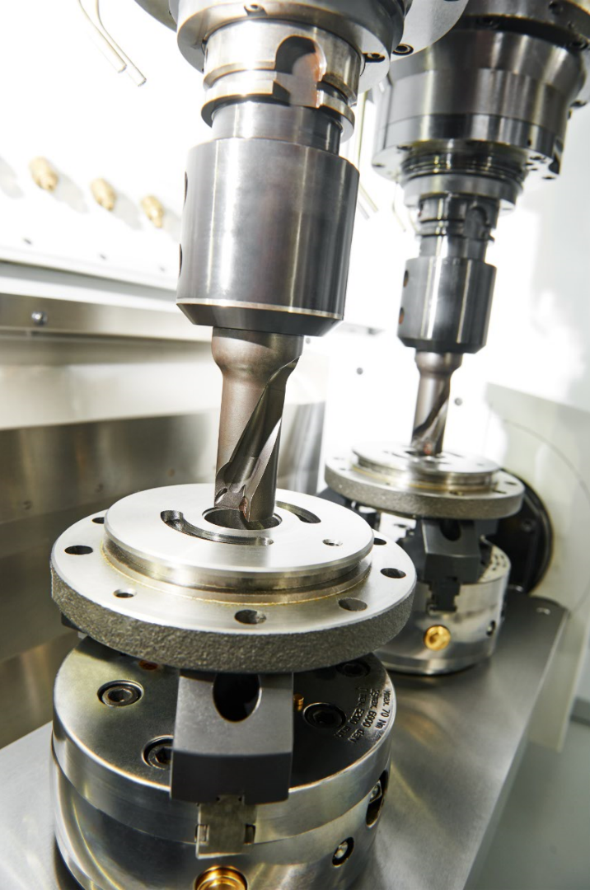
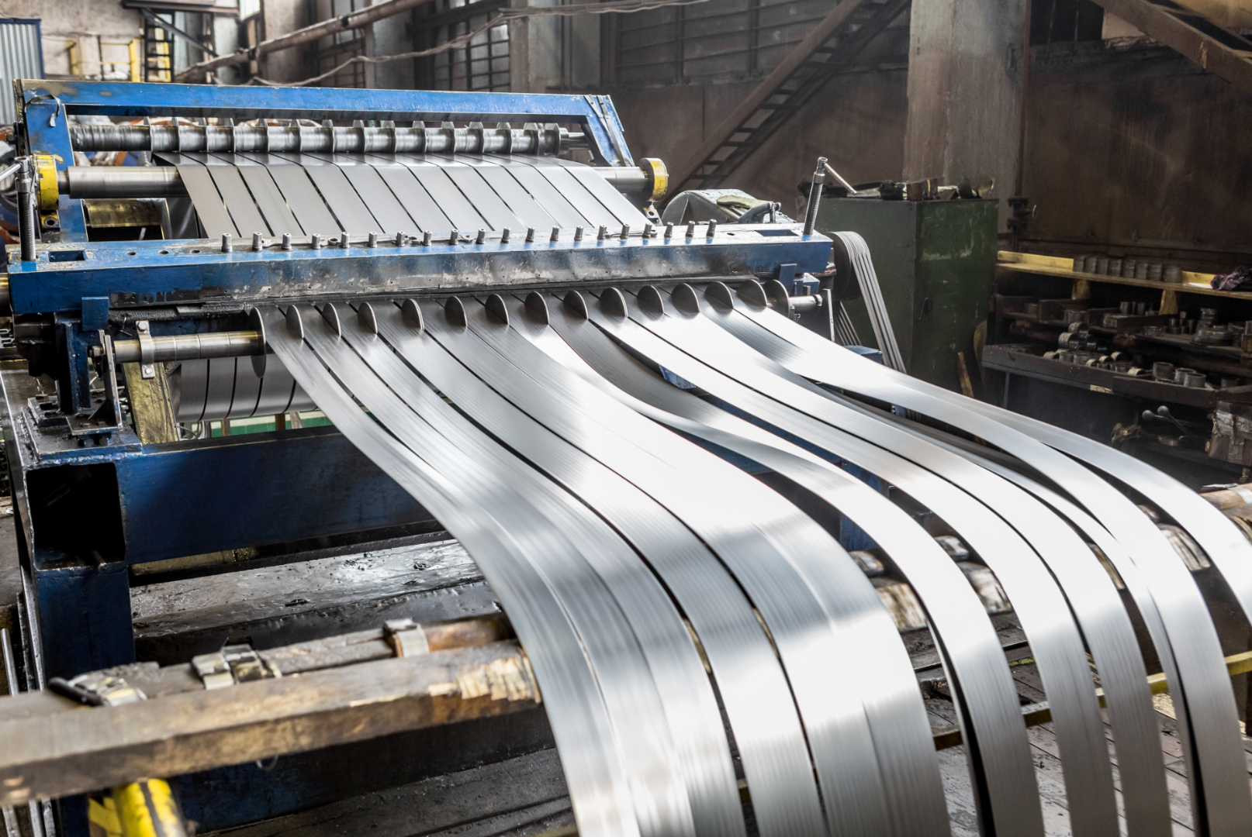
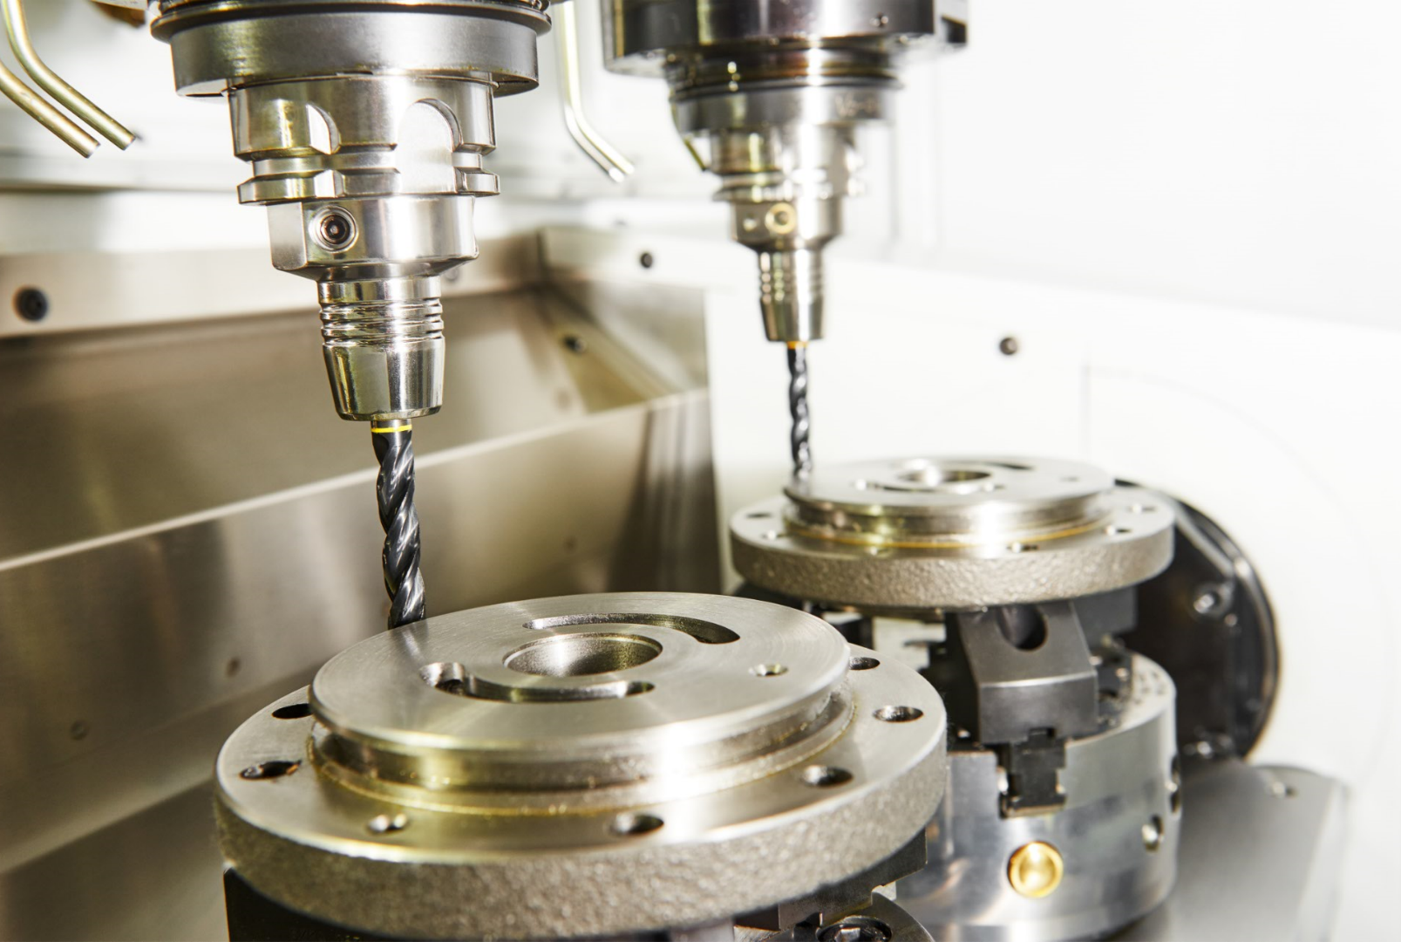
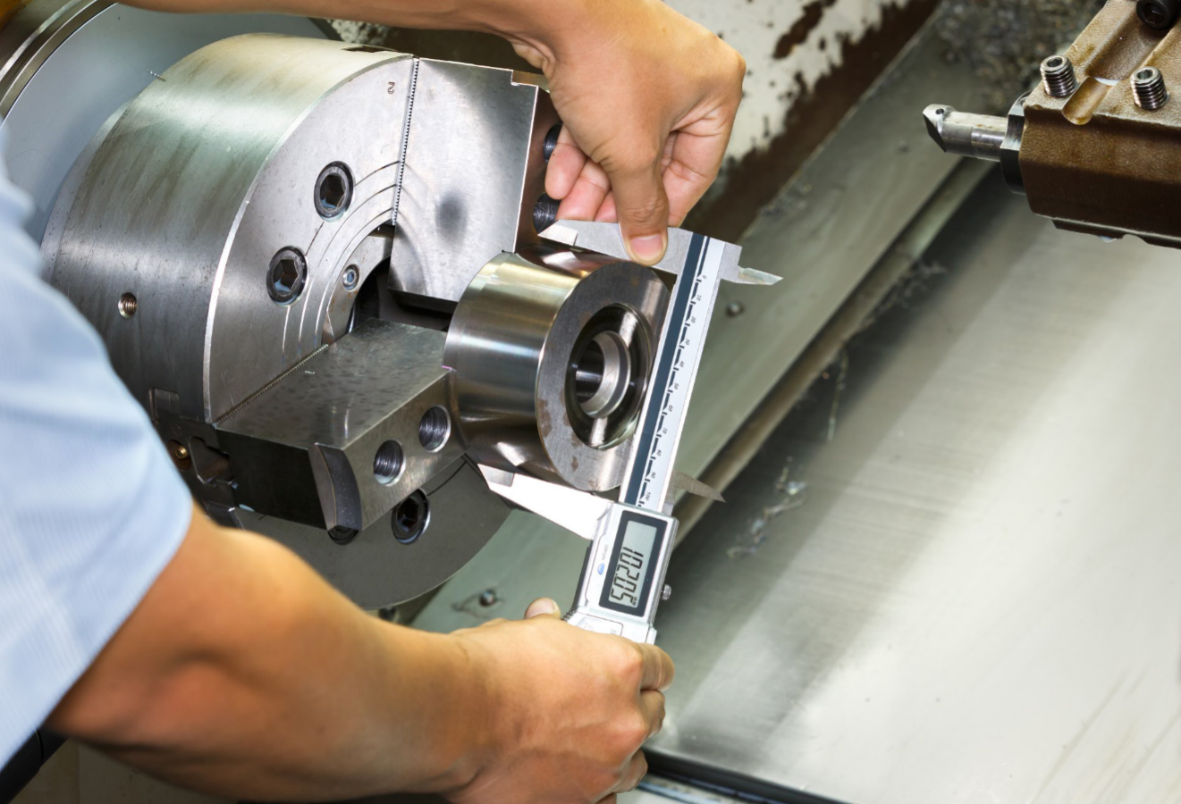
Attendee profile
Aerospace
Electric devices
Telecomunications & electronic devices
Heavy machinery - Agriculture
Furtiniture manufacturers
Hardware distributors
Automotive industry
Energy supply
Construction engineering
Construction fixings
Assembly and installations
Fastener manufacturing technology
Organized by

Slide 6
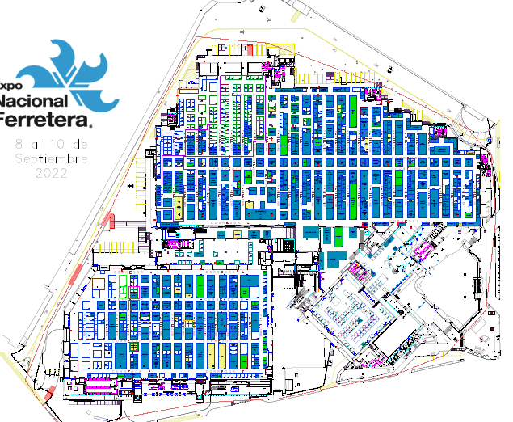
Salón de evento especiales

Slide 7
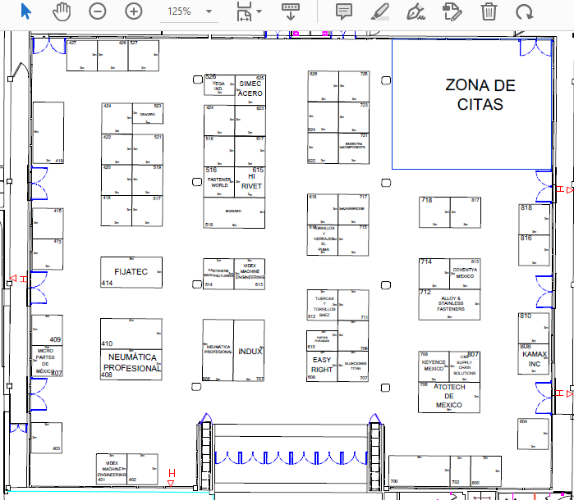
Salón de eventos especiales

